Slide 1
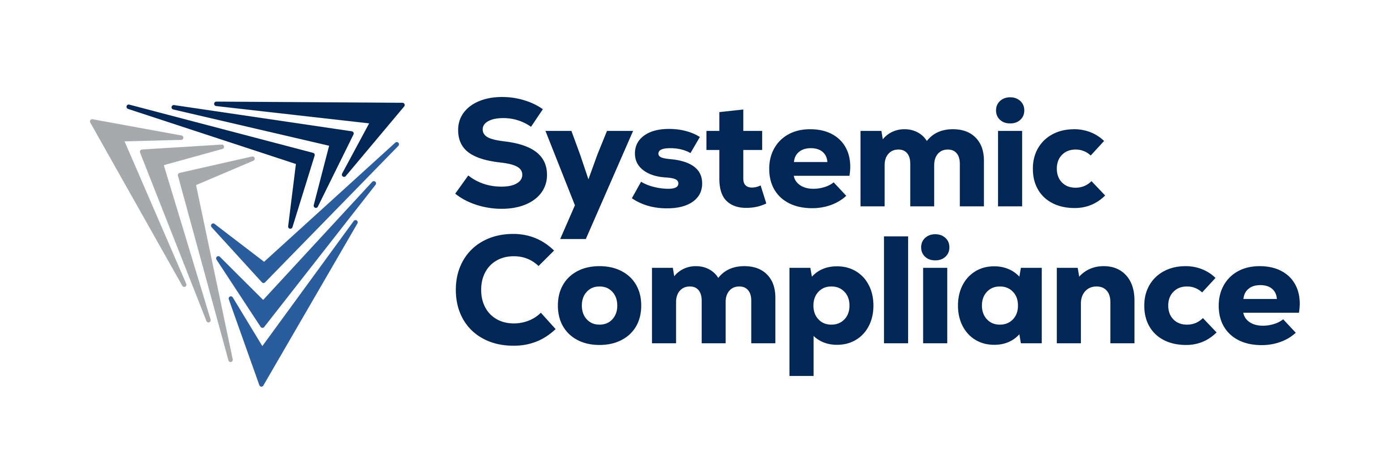
SYSTEMIC COMPLIANCE
SC.IMS + SC.ORB
What we have, what it does, the markets, and the strategy to maximize value
Prepared for David O'Hara, Improving · 2026-07-08 · Internal / Confidential

Slide 2
The thesis: compliance should be systemic
• Compliance today is fragmented - requirements, procedures, records, and training sit in separate silos.
• A change in one place is rarely reflected everywhere it matters (the hidden cost of fragmentation).
• SC's thesis: one connected system where every record links to the requirement that justifies it, and a change ripples automatically to everything it touches.
• Proven first in pipeline safety - the most requirement-dense, contractor-heavy, multi-jurisdiction corner of the market.
Systemic Compliance · SC.IMS + SC.ORB briefing · Confidential
2

Slide 3
What SC is: a compliance operating system
• Not a pipeline consultancy with software - a vertical-agnostic compliance operating system whose first instantiation is pipeline safety.
• Pipeline safety is the proof instance and the cash engine; the asset underneath is the system.
• A stack of separable assets: (1) the IP & framework (SC.IMS); (2) the platform & recurring revenue (SC.ORB); (3) the services & consulting lines (the cash engine).
• Buyers underwrite a larger market and a longer runway for a portable operating system than for a single-vertical firm.
Systemic Compliance · SC.IMS + SC.ORB briefing · Confidential
3

Slide 4
SC.IMS - the framework and the IP
• Regulatory-linkage / crosswalk engine: a cross-standard, multi-state requirements graph; requirement-to-record traceability as a byproduct. The most defensible IP.
• MOC ripple engine: predicts every upstream/downstream impact of a change, each labeled with the link that explains it - closed-loop, with audit trail.
• Competence Architect: one authored Training Object renders every vehicle - ILT, self-study, OJT, workbook, exam, CBT - to the operator's own procedure.
• Competence & Progression Framework: the most portable IP - what SC carries into a new vertical (rail, power, chemical).
• Gap-analysis + peer-benchmarking corpus: source-traceable analysis; an accreting, de-identified operator benchmark that strengthens with every engagement.
Systemic Compliance · SC.IMS + SC.ORB briefing · Confidential
4

Slide 5
SC.ORB - the platform
• The software that operationalizes the framework at scale: 65 features across 18 business areas (35 built, 8 in progress, 22 planned; planned = in scope).
• Areas incl. OQ, ORB / Requirements Repository, MOC, Safe Work Permit, D&A, COI, LMS, Audits, SC-Score, dashboards, and AI assistance.
• Operator-funded model: $98 per records-bearing worker/yr (contractors not charged to stay in), plus a banded platform license; representative operator ~ $70k/yr (internal figures).
• The recurring core - the asset a buyer pays a premium for.
Systemic Compliance · SC.IMS + SC.ORB briefing · Confidential
5

Slide 6
How SC.IMS and SC.ORB fit together (the opportunity)
• SC.IMS is where the intelligence lives; SC.ORB is how it is delivered at scale.
• Today the engines run as rigorous human-run capability (linkage, MOC ripple, Competence Architect, peer-benchmarking).
• The value-multiplier: productize those engines INTO SC.ORB - linkage graph as the requirements backbone, ripple engine as the MOC module, Competence Architect as the training/LMS engine, peer-benchmarking as a data product.
• Integration turns bespoke expertise into durable, sellable software and recurring revenue - the core of where we want Improving's guidance.
Systemic Compliance · SC.IMS + SC.ORB briefing · Confidential
6

Slide 7
What we sell: four front doors, one connected system
• Contractor Management: contractors qualified to your procedures, with SWP, D&A, and COI enforced on SC.ORB; expands toward a full PSMS.
• Training & Competence: a competence framework and operator-specific courses in four formats with equivalency crediting, in your LMS or ours.
• Consulting: scoped senior expertise across 49 CFR 190-199 for a specific deadline, inspection, or gap.
• PSMS / IMS build & assessment readiness: conformance scorecards and a remediation roadmap, expanding to the full integrated management system.
• Underneath all four: SC.ORB (the recurring platform) + Co-Source (Foundation / Essential / Managed / Embedded). Consulting lands the relationship; the subscription is the durable asset. Every engagement starts with a Phase-0 assessment.
Systemic Compliance · SC.IMS + SC.ORB briefing · Confidential
7

Slide 8
The pricing disruption is the message
• Fixed-price, value-based consulting: instead of the industry's time-and-materials culture.
• Operator-funded platform: instead of contractor-pays incumbents (Veriforce, ISN) - moving who pays removes the switching cost and frees the contractor; incumbents cannot copy it.
• Co-Source: priced on value, costed on capacity - a fractional compliance department, not a single hire.
• Two-sided demand loop: contractors become distribution (not cost), and consulting manufactures the pull into the platform.
Systemic Compliance · SC.IMS + SC.ORB briefing · Confidential
8

Slide 9
Markets
• Beachhead: U.S. pipeline operators - gas transmission, midstream, hazardous-liquid, gas distribution (LDC) - plus their contractors and trade associations.
• Best-fit signals: regulatory intensity; contractor-heaviness; multi-state footprint; incumbent platform (Veriforce/ISN = switch targets).
• The live pipeline already spans these segments, with near-term reference logos and a flagship account in progress.
• Portability: the linkage engine and CPF are vertical-agnostic - the same operating system extends to rail, power, chemical, enlarging the market and the multiple.
Systemic Compliance · SC.IMS + SC.ORB briefing · Confidential
9

Slide 10
Strategy: growth and maximizing value
• Objective: enterprise value in 3-4 years, with optionality preserved.
• The flywheel: use fixed-price consulting cash to fund the recurring-revenue build and operational de-risking - consulting funds the asset, it is not the destination.
• Value drivers we are building: recurring revenue; a defensible moat (linkage IP + operator-funded model); clean, separable IP; founder-independent operations; a documented, portable framework.
Systemic Compliance · SC.IMS + SC.ORB briefing · Confidential
10

Slide 11
Optionality: three exit doors, crown-jewel IP
• Sale of the whole company: the default path.
• License part of the IP / structure: the regulatory-linkage dataset/graph is the natural candidate.
• New-vertical venture: repurpose the framework for another regulated vertical - the CPF is what travels.
• Crown-jewel separable IP: the linkage dataset/graph, the CPF, the MOC ripple engine, Competence Architect, and the peer-benchmarking corpus.
Systemic Compliance · SC.IMS + SC.ORB briefing · Confidential
11

Slide 12
Where we would value Improving's guidance
• Integration architecture & roadmap: how to productize the SC.IMS engines into SC.ORB - sequencing, build-vs-buy, data model.
• Positioning for marketing potential: how to tell the 'compliance operating system' story to win category leadership and pull.
• Maximizing company value: product, data, and IP structure that supports the highest multiple and the widest set of exit options.
• AI architecture for delivering the services: a path to a closed / private AI environment and/or a secure hybrid approach that protects client data and SC's proprietary IP while preserving the speed advantage.
Systemic Compliance · SC.IMS + SC.ORB briefing · Confidential
12

Slide 13
Compliance should be systemic.
A compliance operating system - proven in pipeline safety, portable across regulated industries - with defensible IP, recurring revenue, and multiple paths to value.
Systemic Compliance · Confidential · 2026-07-08

